Slide 1
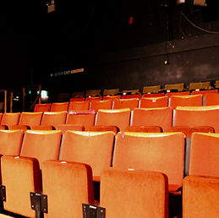
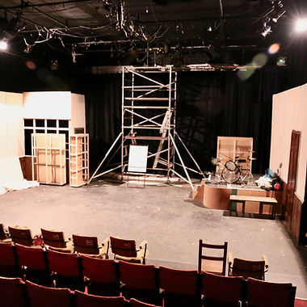
CYTO, South Norwood
Croydon Youth Theatre Organisation (www.cyto.org.uk) has been providing young people with drama and technical theatre workshops and the chance to appear in productions for over 50 years. They are located in Oakley Road, South Norwood in premises they have rented for many years from the Council.
Last year they asked the Council if we would consider a Community Asset Transfer (CAT) to enable them to increase investment in the building. A CAT is typically a 25 year lease, at less than market value, but the organisation taking it on also takes on responsibility for internal and external maintenance and all the statutory safety checks.
CYTO chose to go down this route as it meant they would be able to apply for a wider range of funding opportunities to allow them to undertake building improvements and ensure it continues to provide a much- loved community facility for the borough’s young people.
Community Asset Transfer Case Study
As well as working up a business plan with detailed financial forecasts, CYTO undertook a condition survey and a fire risk assessment to ensure they were fully sighted on the scale of the task they were undertaking. These steps gave CYTO and the Council the confidence to proceed with the transfer, and in June 2023 the new lease was signed.

Slide 2
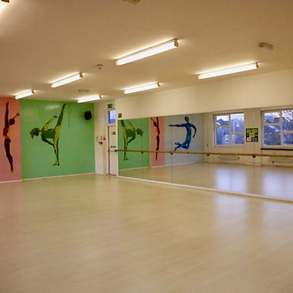
David Page, the Chair of CYTO, along with his fellow trustees have taken this step to provide greater certainty for the organisation's future. However, securing the lease was just one element. They were equally mindful of the need to have an effective management committee and a solid foundation of talented professionals, volunteers, supporters, etc and put in a good deal of time and effort to ensure this was the case.
This building is also serving the wider needs of the area as the facilities are available for others to use. CYTO offer affordable hire of the theatre, the dance studio and rehearsal space. If you would like to find out more, please visit www.cyto.org.uk/our-spaces

